Slide 1
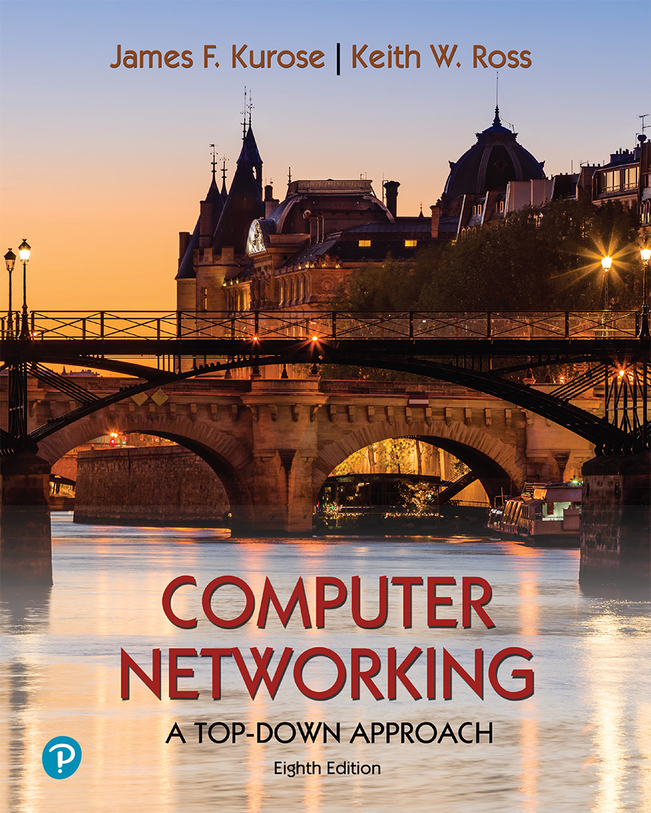
Chapter 8 Security
Computer Networking: A Top-Down Approach 8th edition Jim Kurose, Keith Ross Pearson, 2020
Acknowledgement: Based on the textbook’s website: https://gaia.cs.umass.edu/kurose_ross/index.php
Notes:
Version History
8.0 (May 2020)
All slides reformatted for 16:9 aspect ratio
All slides updated to 8th edition material
Use of Calibri font, rather that Gill Sans MT
Add LOTS more animation throughout
lighter header font
wireless security completely redone (updated WiFi and added 4G/5G)
SSL material replaces by TLS 1.3 (up-to-date)
V8.2 (Feb 2022)
Minor corrections

Slide 2

Chapter 8 outline
What is network security?
Principles of cryptography
Authentication, message integrity
Securing e-mail
Securing TCP connections: TLS
Network layer security: IPsec
Security in wireless and mobile networks
Operational security: firewalls and IDS

Slide 3



Authentication
Goal: Bob wants Alice to “prove” her identity to him
Protocol ap1.0: Alice says “I am Alice”
“I am Alice”
failure scenario??

Slide 4
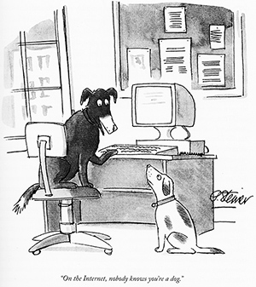
Authentication
Goal: Bob wants Alice to “prove” her identity to him
Protocol ap1.0: Alice says “I am Alice”
in a network, Bob can not “see” Alice, so Trudy simply declares herself to be Alice
“I am Alice”

Slide 5
Authentication: another try
Goal: Bob wants Alice to “prove” her identity to him
Protocol ap2.0: Alice says “I am Alice” in an IP packet containing her source IP address
Alice’s
IP address
“I am Alice”
failure scenario??

Slide 6
Authentication: another try
Goal: Bob wants Alice to “prove” her identity to him
Protocol ap2.0: Alice says “I am Alice” in an IP packet containing her source IP address
Trudy can create
a packet “spoofing”
Alice’s address
Alice’s
IP address
“I am Alice”

Slide 7
Authentication: a third try
Goal: Bob wants Alice to “prove” her identity to him
Protocol ap3.0: Alice says “I am Alice” and sends her secret password to “prove” it.
Alice’s
IP addr
Alice’s
password
“I am Alice”
failure scenario??
Alice’s
IP addr
OK

Slide 8
Authentication: a third try
Goal: Bob wants Alice to “prove” her identity to him
Protocol ap3.0: Alice says “I am Alice” and sends her secret password to “prove” it.
playback attack: Trudy records Alice’s packet
and later
plays it back to Bob
Alice’s
IP addr
Alice’s
password
“I am Alice”
Alice’s
IP addr
Alice’s
password
“I am Alice”
Alice’s
IP addr
OK

Slide 9
Authentication: a modified third try
Goal: Bob wants Alice to “prove” her identity to him
Protocol ap3.0: Alice says “I am Alice” and sends her encrypted secret password to “prove” it.
Alice’s
IP addr
encrypted
password
“I am Alice”
failure scenario??
Alice’s
IP addr
OK

Slide 10
Authentication: a modified third try
Goal: Bob wants Alice to “prove” her identity to him
Protocol ap3.0: Alice says “I am Alice” and sends her encrypted secret password to “prove” it.
Alice’s
IP addr
encrypted
password
“I am Alice”
playback attack still works: Trudy records Alice’s packet
and later plays it back to Bob
Alice’s
IP addr
encrypted
password
“I am Alice”
Alice’s
IP addr
OK

Slide 11
Authentication: a fourth try
Goal: avoid playback attack
nonce: number (R) used only once-in-a-lifetime
protocol ap4.0: to prove Alice “live”, Bob sends Alice nonce, R
Alice must return R, encrypted with shared secret key
“I am Alice”
R
K (R)
Bob know Alice is live, and only Alice knows key to encrypt nonce, so it must be Alice!
A-B
Failures, drawbacks?

Slide 12
Authentication: ap5.0
ap4.0 requires shared symmetric key - can we authenticate using public key techniques?
ap5.0: use nonce, public key cryptography
“I am Alice”
R
Bob computes
+
-
-
K
(K (R)) = R
K (R)
A
A
A
and knows only Alice could have the private key, that encrypted R such that
Send me your public key
+
K (R)
+
-
A
K
A
(K (R)) = R
A

Slide 13
Authentication: ap5.0 – there’s still a flaw!
man (or woman) in the middle attack: Trudy poses as Alice (to Bob) and as Bob (to Alice)
I am Alice
I am Alice
?
R
-
K (R)
T
R
Where are mistakes made here?
Send me your public key
-
+
K (R)
K
Bob computes
A
T
+
-
Send me your public key
K
(K (R)) = R,
+
T
T
K
authenticating
Trudy as Alice
A
Trudy recovers m:
+
+
-
+
K (m)
Trudy recovers Bob’s m:
m = K (K (m))
Bob sends a personal message, m to Alice
-
+
K (m)
T
T
m = K (K (m))
A
T
A
A
sends m to Alice encrypted with Alice’s public key
and she and Bob meet a week later in person and discuss m, not knowing Trudy knows m

Slide 14
Chapter 8 outline
What is network security?
Principles of cryptography
Authentication, message integrity
Securing e-mail
Securing TCP connections: TLS
Network layer security: IPsec
Security in wireless and mobile networks
Operational security: firewalls and IDS

Slide 15

Digital signatures
cryptographic technique analogous to hand-written signatures:
sender (Bob) digitally signs document: he is document owner/creator.
verifiable, nonforgeable: recipient (Alice) can prove to someone that Bob, and no one else (including Alice), must have signed document
simple digital signature for message m:
Bob signs m by encrypting with his private key K_{B}, creating “signed” message, K_{B}⁻(m)
-
Bob’s private
key
-
Bob’s message, m
K
m,K
(m)
B
B
Dear Alice
Oh, how I have missed you. I think of you all the time! …(blah blah blah)
Bob
Dear Alice
Oh, how I have missed you. I think of you all the time! …(blah blah blah)
Bob
Public key
encryption
algorithm
-
K
(m)
B

Slide 16
Digital signatures
-
suppose Alice receives msg m, with signature: m, K_{B}(m)
Alice verifies m signed by Bob by applying Bob’s public key K_{B} to K_{B}(m) then checks K_{B}(K_{B}(m) ) = m.
If K_{B}(K_{B}(m) ) = m, whoever signed m must have used Bob’s private key
+
-
+
-
+
-
Alice thus verifies that:
Bob signed m
no one else signed m
Bob signed m and not m’
non-repudiation:
Alice can take m, and signature K_{B}(m) to court and prove that Bob signed m
-

Slide 17
Message digests
computationally expensive to public-key-encrypt long messages
goal: fixed-length, easy- to-compute digital “fingerprint”
apply hash function H to m, get fixed size message digest, H(m)
large
message
m
H: Hash
Function
H(m)
Hash function properties:
many-to-1
produces fixed-size msg digest (fingerprint)
given message digest x, computationally infeasible to find m such that x = H(m)

Slide 18
Internet checksum: poor crypto hash function
Internet checksum has some properties of hash function:
produces fixed length digest (16-bit sum) of message
is many-to-one
but given message with given hash value, it is easy to find another message with same hash value:
message
ASCII format
message
ASCII format
I O U 1
0 0 . 9
9 B O B
49 4F 55 31
30 30 2E 39
39 42 D2 42
I O U 9
0 0 . 1
9 B O B
49 4F 55 39
30 30 2E 31
39 42 D2 42
B2 C1 D2 AC
different messages
but identical checksums!
B2 C1 D2 AC

Slide 19
Digital signature = signed message digest
Bob sends digitally signed message:
Alice verifies signature, integrity of digitally signed message:
large
message
m
H: Hash
Function
H(m)
encrypted
message digest
-
K_{B}(H(m))
digital
signature
(encrypt)
Bob’s
private
key
large
message
m
-
K
B
digital
signature
(decrypt)
Bob’s
public
key
+
encrypted
message digest
H: Hash
function
K
B
+
-
K_{B}(H(m))
H(m)
H(m)
?
equal

Slide 20
Hash function algorithms
MD5 hash function widely used (RFC 1321)
computes 128-bit message digest in 4-step process.
arbitrary 128-bit string x, appears difficult to construct msg m whose MD5 hash is equal to x
SHA-1 is also used
US standard [NIST, FIPS PUB 180-1]
160-bit message digest

Slide 21
Authentication: ap5.0 – let’s fix it!!
Recall the problem: Trudy poses as Alice (to Bob) and as Bob (to Alice)
I am Alice
I am Alice
?
R
-
K (R)
T
R
Where are mistakes made here?
Send me your public key
-
+
K (R)
K
Bob computes
A
T
+
-
Send me your public key
K
(K (R)) = R,
+
T
T
K
authenticating
Trudy as Alice
A
Trudy recovers m:
+
+
-
+
K (m)
Trudy recovers Bob’s m:
m = K (K (m))
Bob sends a personal message, m to Alice
-
+
K (m)
T
T
m = K (K (m))
A
T
A
A
sends m to Alice encrypted with Alice’s public key
and she and Bob meet a week later in person and discuss m, not knowing Trudy knows m

Slide 22
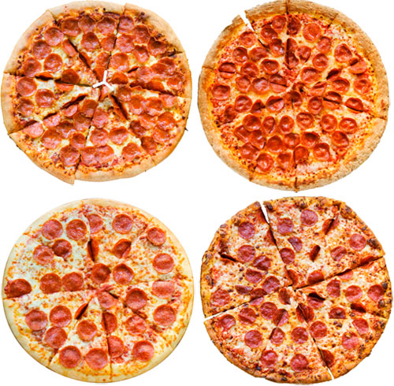
Need for certified public keys
motivation: Trudy plays pizza prank on Bob
Trudy creates e-mail order: Dear Pizza Store, Please deliver to me four pepperoni pizzas. Thank you, Bob
Trudy signs order with her private key
Trudy sends order to Pizza Store
Trudy sends to Pizza Store her public key, but says it’s Bob’s public key
Pizza Store verifies signature; then delivers four pepperoni pizzas to Bob
Bob doesn’t even like pepperoni

Slide 23
Public key Certification Authorities (CA)
certification authority (CA): binds public key to particular entity, E
entity (person, website, router) registers its public key with CE provides “proof of identity” to CA
CA creates certificate binding identity E to E’s public key
certificate containing E’s public key digitally signed by CA: CA says “this is E’s public key”
Bob’s
public
key
digital
signature
(encrypt)
+
+
K
K
B
B
CA’s
private
key
-
certificate for Bob’s public key, signed by CA
Bob’s
identifying information
K
CA

Slide 24
Public key Certification Authorities (CA)
when Alice wants Bob’s public key:
gets Bob’s certificate (Bob or elsewhere)
apply CA’s public key to Bob’s certificate, get Bob’s public key
+
digital
signature
(decrypt)
Bob’s
public
key
K
+
B
K
B
CA’s
public
key
+
K
CA

Slide 25
Chapter 8 outline
What is network security?
Principles of cryptography
Authentication, message integrity
Securing e-mail
Securing TCP connections: TLS
Network layer security: IPsec
Security in wireless and mobile networks
Operational security: firewalls and IDS

Slide 26
Secure e-mail: confidentiality
Alice wants to send confidential e-mail, m, to Bob.
K_{S}
.
K_{S}(m )
K_{S}(m )
.
m
K_{S}( )
K_{S}( )
m
+
-
Internet
K_{S}
.
-
.
+
K_{S}
K_{B}( )
+
+
K_{B}( )
K_{B}(K_{S} )
K_{B}(K_{S} )
+
-
K_{B}
K_{B}
Alice:
generates random symmetric private key, K_{S}
encrypts message with K_{S} (for efficiency)
also encrypts K_{S} with Bob’s public key
sends both K_{S}(m) and K⁺_{B}(K_{S}) to Bob

Slide 27
Secure e-mail: confidentiality (more)
Alice wants to send confidential e-mail, m, to Bob.
K_{S}
.
K_{S}(m )
K_{S}(m )
.
m
K_{S}( )
K_{S}( )
m
+
-
Internet
K_{S}
.
-
.
+
K_{S}
K_{B}( )
+
+
K_{B}( )
K_{B}(K_{S} )
K_{B}(K_{S} )
+
-
K_{B}
K_{B}
Bob:
uses his private key to decrypt and recover K_{S}
uses K_{S} to decrypt K_{S}(m) to recover m

Slide 28
Secure e-mail: integrity, authentication
Alice wants to send m to Bob, with message integrity, authentication
-
+
K_{A}
K_{A}
.
.
-
-
.
-
K_{A}(H(m))
K_{A}(H(m))
+
H(m )
m
H( )
K_{A}( )
K_{A}( )
+
-
compare
Internet
.
m
H( )
H(m )
m
Alice digitally signs hash of her message with her private key, providing integrity and authentication
sends both message (in the clear) and digital signature

Slide 29
Secure e-mail: integrity, authentication
Alice sends m to Bob, with confidentiality, message integrity, authentication
-
K_{A}
-
confidentiality
.
.
K_{A}(H(m))
m
-
K_{S}
H( )
K_{A}( )
.
K_{S}(m )
+
K_{S}( )
m
+
Internet
message integrity, authentication
.
K_{S}
+
K_{B}( )
+
K_{B}(K_{S} )
+
K_{B}
Alice uses three keys: her private key, Bob’s public key, new symmetric key
What are Bob’s complementary actions?

